Slide 1
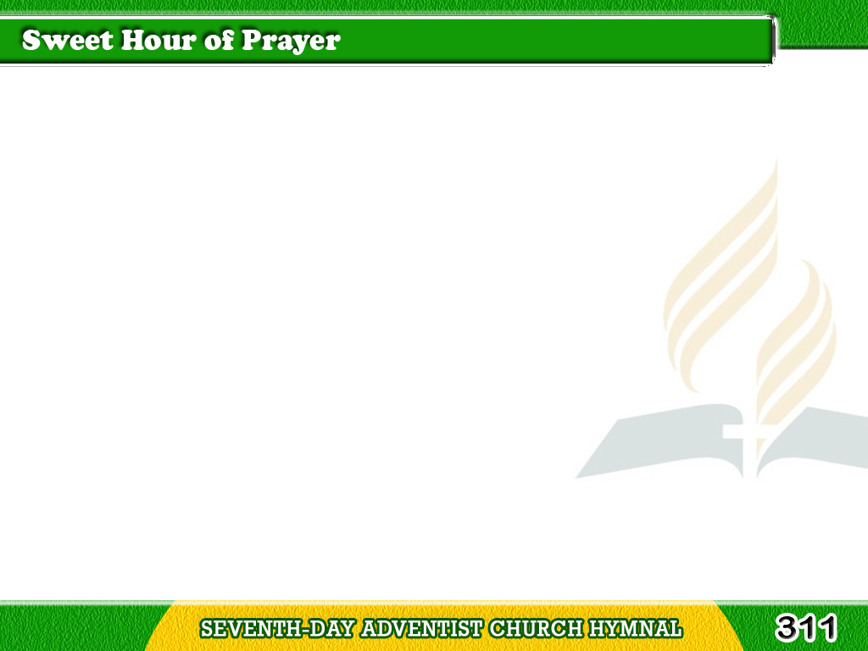
1/3
Sweet hour of prayer,
sweet hour of prayer,
That calls me
from a world of care,
Tagalog
Version

Slide 2
1/3
And bids me,
at my Father’s throne,
Make all my wants
and wishes known!
Tagalog
Version

Slide 3
1/3
In seasons of distress
and grief,
My soul has often
found relief,
Tagalog
Version

Slide 4
1/3
And oft escaped
the tempters snare,
By thy return,
sweet hour of prayer.
Tagalog
Version

Slide 5
2/3
Sweet hour of prayer!
sweet hour of prayer!
Thy wings
shall my petition bear
Tagalog
Version

Slide 6
2/3
To Him whose truth
and faithfulness
Engage the waiting
soul to bless.
Tagalog
Version

Slide 7
2/3
And since He bids me
seek His face,
Believe His word,
and trust His grace,
Tagalog
Version

Slide 8
2/3
I’ll cast on Him
my every care,
And wait for thee,
sweet hour of prayer.
Tagalog
Version

Slide 9
3/3
Sweet hour of prayer!
sweet hour of prayer!
May I thy consolation share
Tagalog
Version

Slide 10
3/3
Till from Mount Pisgah’s
lofty height
I view my home
and take my flight.
Tagalog
Version

Slide 11
3/3
In my immortal
flesh I’ll rise
To seize the everlasting prize.
Tagalog
Version

Slide 12
3/3
And shout while passing
through the air,
“Farewell, farewell,
sweet hour of prayer!”
Tagalog
Version

